Slide 1
Lecture #11
SOFT COMPUTING
INT508

Slide 2
Radial basis function neural networks
A kind of supervised neural networks
Design of NN as curve-fitting problem
Learning
  find surface in multidimensional space best fit to training data
Generalization
  Use of this multidimensional surface to interpolate the test data

Slide 3
Radial basis function neural networks
Approximate function with linear combination of Radial basis functions
F(x) = Σ w_{i} h(x)
h(x) is mostly Gaussian function

Slide 4
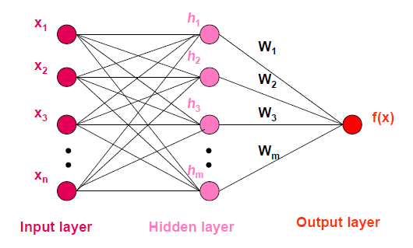
Radial basis function neural networks
There are only three layers: Input, Hidden and Output. There is only one hidden layer.

Slide 5
Radial basis function neural networks
Input layer
  Source nodes that connect to the network to its environment
Hidden layer
  Hidden units provide a set of basis function
  High dimensionality
Output layer
  Linear combination of hidden functions

Slide 6
Radial basis function neural networks
The hidden layer provides a non-linear transformation of the input space to the hidden space, which is assumed usually of high enough dimension.
The output layer combines in a linear way the activations of the hidden layer.
Note: The RBF model owns its development on ideas of fitting hyper-surfaces to data points in a high-dimensional space.
In Numerical Analysis, radial-basis functions were introduced for the solution of real multivariate interpolation problems.

Slide 7
Radial basis function neural networks
In the RBF model the hidden units provide a set of “functions” that constitute an arbitrary “basis” for the input patterns when they are expanded to the hidden space.
The inspiration for the RBF model is based on Cover’s theorem (1965) on the separability of patterns:
“A complex pattern-classification problem cast in a high-dimensional space nonlinearly is more likely to be linearly separable than in a low-dimensional space”.

Slide 8
Radial basis function neural networks
f(x) = ∑ w_{j}h_{j}(x)
h_{j}(x) = exp( -(x-c_{j})² / r_{j}² )
Where c_{j} is center of a region,
r_{j} is width of the receptive field

Slide 9
Radial basis function neural networks
XOR Problem
The XOR problem is one of the popular examples of a nonlinear classification problem.
In this problem there are four points (patterns), namely, (1,1), (0,1), (0,0) and (1,0), in a two dimensional input spaces , as The requirement is to construct a pattern classifier that gives the binary input 0 in response to the input patterns (1,1) or (0,0), and the binary output 1 in response to the input pattern (0,1) or (1,0).
As discussed before, RBFs transform a nonlinearly separable problem into a linearly separable problem basically converting the input space into higher dimensional space.

Slide 10
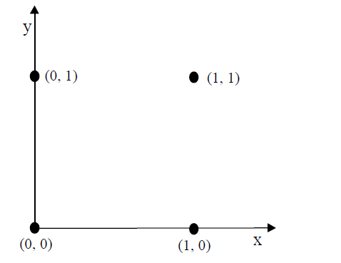
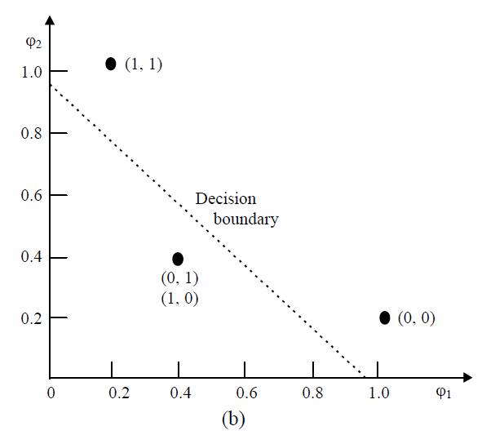
Radial basis function neural networks

Slide 11

Radial basis function neural networks
where t1 and t2 are the centers of the gaussian functions.

Slide 12
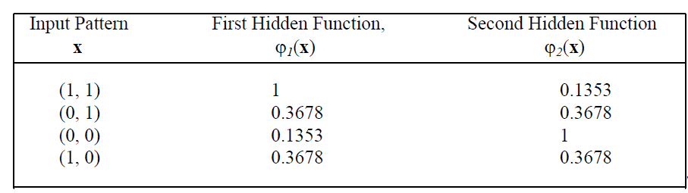
Radial basis function neural networks

Slide 13
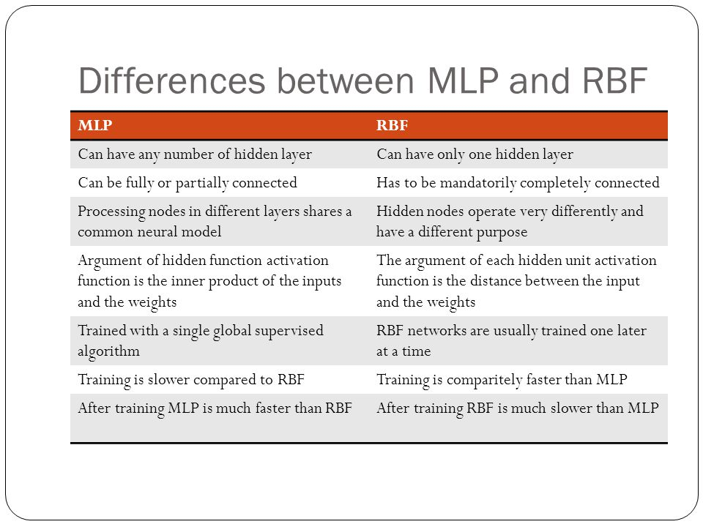

Slide 14
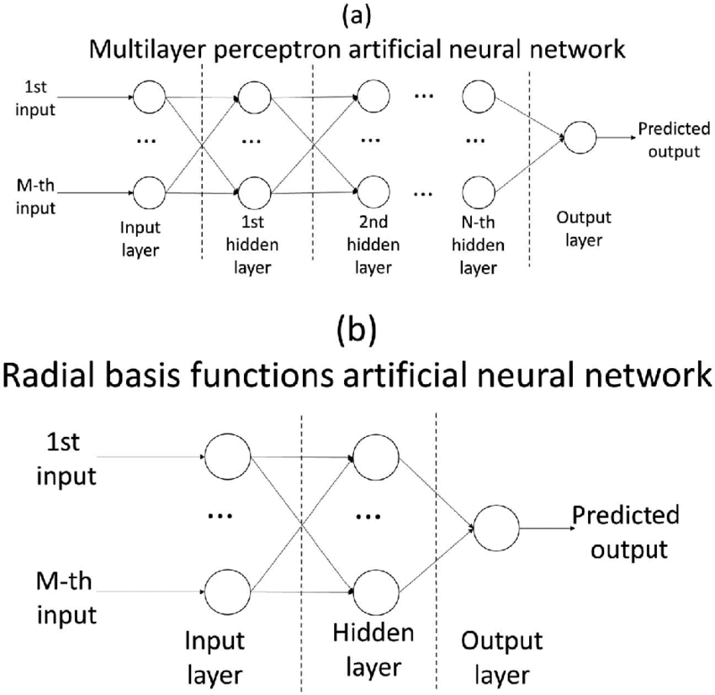

Slide 15
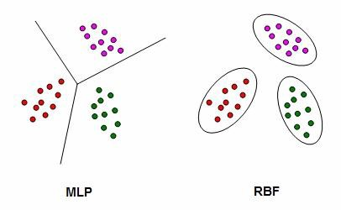

Slide 16
1. Having multiple perceptrons can solve the XOR problem satisfactorily because each perceptron can partition off a linear part of the space itself, and they can then combine their results.
True - This works always, and these multiple perceptrons learn to classify even complex problems.
False - Perceptrons are mathematically incapable of solving linearly inseparable functions, no matter what you do
True - Perceptron can do this but are unable to learn to do it - they have to be explicitly hand-coded
False - Just having a single perceptron is enough

Slide 17
1. Having multiple perceptrons can solve the XOR problem satisfactorily because each perceptron can partition off a linear part of the space itself, and they can then combine their results.
True - This works always, and these multiple perceptrons learn to classify even complex problems.
False - Perceptrons are mathematically incapable of solving linearly inseparable functions, no matter what you do
True - Perceptron can do this but are unable to learn to do it - they have to be explicitly hand-coded
False - Just having a single perceptron is enough

Slide 18
2. A 3-input neuron is trained to output a 0 when the input is 110 and a 1 when the input is 111. After generalization, the output will be 0, when and only when the input is:
000 or 110 or 011 or 101
000 or 010 or 110 or 100
100 or 111 or 101 or 001
010 or 100 or 110 or 101

Slide 19
2. A 3-input neuron is trained to output a 0 when the input is 110 and a 1 when the input is 111. After generalization, the output will be 0, when and only when the input is:
000 or 110 or 011 or 101
000 or 010 or 110 or 100
100 or 111 or 101 or 001
010 or 100 or 110 or 101

Slide 20
3 What is the name of the network, which includes backward links from the output to the inputs as well as the hidden layers?
Perceptron
Self-organizing maps
Multi-layered perceptron
Recurrent neural network

Slide 21
3 What is the name of the network, which includes backward links from the output to the inputs as well as the hidden layers?
Perceptron
Self-organizing maps
Multi-layered perceptron
Recurrent neural network

Slide 22
4. Which of the following is true for unsupervised learning?
Some specific output values are disclosed
Some specific output values aren't disclosed
No relevant inputs value is specified
Both inputs as well outputs are specified
Neither inputs nor outputs are given

Slide 23
4. Which of the following is true for unsupervised learning?
Some specific output values are disclosed
Some specific output values aren't disclosed
No relevant inputs value is specified
Both inputs as well outputs are specified
Neither inputs nor outputs are given

Slide 24
5. Feature of ANN in which ANN creates its own organization of representation of information it receives during learning time is
Adaptive Learning
What-if analysis
Self-Organization
Supervised learning

Slide 25
5. Feature of ANN in which ANN creates its own organization of representation of information it receives during learning time is
Adaptive Learning
What-if analysis
Self-Organization
Supervised learning

Slide 26

12/12/14
CSE510, Lovely Professional University, Phagwara

